Slide 1


Grocery Management System: Automating Inventory
This presentation introduces a comprehensive system for automating inventory management within grocery stores. This system leverages modern technologies to streamline operations, improve accuracy, and enhance efficiency.
by Hemalatha
Artificial Intelligence and Data Science Department

Slide 2
Abstract
Purpose
Technologies
To develop a system for automating inventory management in grocery stores, streamlining operations and reducing manual errors.
Java Swing for the user interface, MySQL hosted on XAMPP for secure and reliable database management.

Slide 3
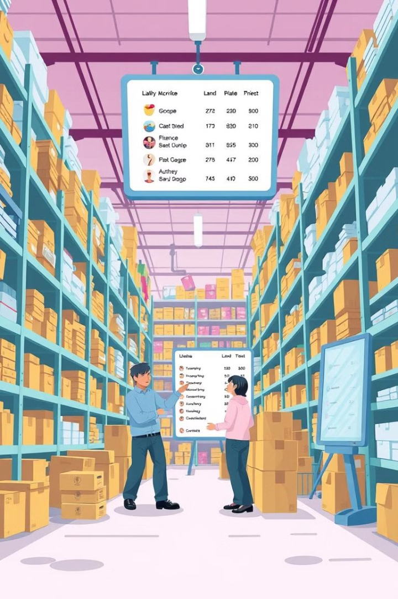
Problem Statement and Solution
Problem
Solution
Manual inventory management in grocery stores is prone to errors and inefficiencies due to the complex nature of product flow.
A digital system that leverages Java, XAMPP, and MySQL to provide real-time inventory tracking, secure storage, and user-friendly management.

Slide 4

Objectives
1
Automation
2
Functionality
Automate key inventory management processes, simplifying operations and reducing manual workloads.
Provide functionalities for adding, viewing, and managing grocery items with ease and accuracy.
3
Database
Leverage XAMPP to host a reliable and secure MySQL database, ensuring data integrity and performance.

Slide 5
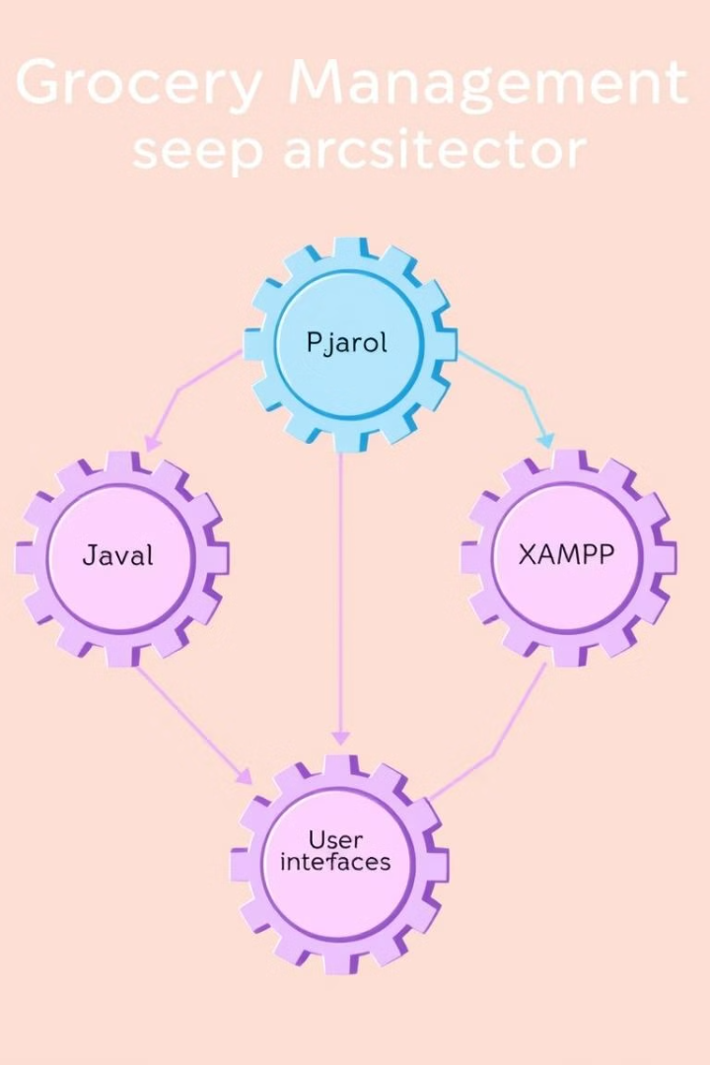




Technologies Used
Java
MySQL
The primary programming language for developing the application, leveraging its robust features and vast libraries.
A powerful and reliable database system, hosted on XAMPP, for managing grocery item data and transactions.
XAMPP
Connector/J
Provides a local development and testing environment for the MySQL database, enabling a streamlined workflow.
Enables seamless communication between the Java application and the MySQL database, ensuring data synchronization.

Slide 6
Key Features
Admin Module
Inventory Module
User Module
Provides secure login for administrators, enabling them to manage grocery items, update inventory, and perform other administrative tasks.
A comprehensive catalog that provides a structured view of all grocery items, including details like name, category, price, and quantity.
Allows users to browse and search the inventory, with role-based access to specific data and functionalities.

Slide 7
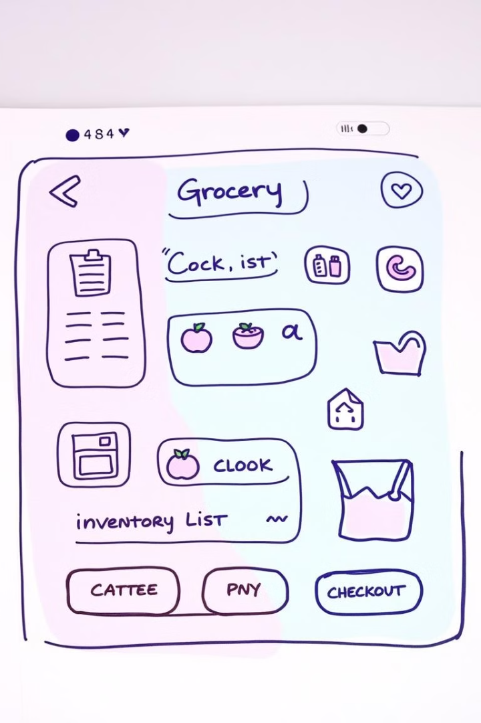
Implementation Details
1
GUI
Developed using Java Swing to provide an intuitive and user-friendly interface for managing inventory and accessing data.
2
Database Design
A carefully designed MySQL schema is hosted on XAMPP to ensure data consistency, reliability, and security.
3
Connectivity
Real-time interaction between the application and the MySQL database is enabled through the MySQL Connector/J, ensuring seamless data flow.

Slide 8



Results
Efficiency
1
Streamlines inventory management processes, reducing manual errors and improving efficiency through automation.
Security
2
Provides secure data storage with XAMPP-hosted MySQL, safeguarding sensitive information like pricing and stock levels.
Usability
3
Offers a user-friendly interface for easy data entry, retrieval, and management, minimizing the learning curve.

Slide 9



Discussion
Strengths
The system leverages real-time updates, a scalable design, and robust data handling with XAMPP and MySQL, ensuring a reliable and adaptable solution.
Future Enhancements
Planned enhancements include low-stock alerts, integration with sales systems, and advanced reporting features to further optimize operations.

Slide 10
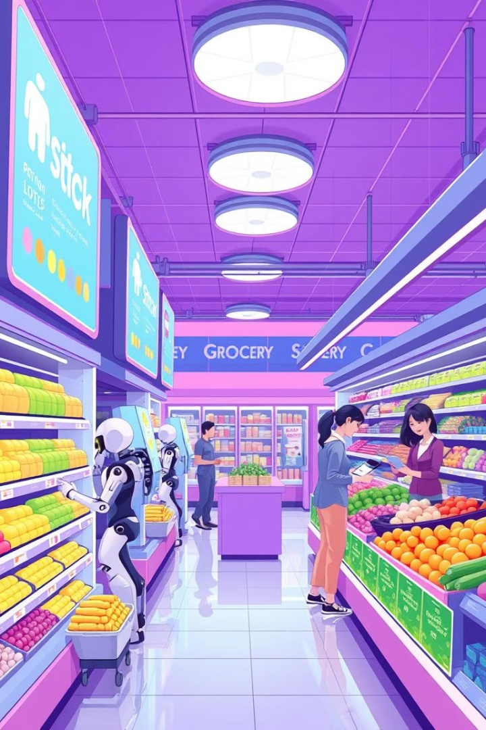
Conclusion
1
Efficiency
Simplifies grocery inventory management, automating processes and reducing manual errors.
2
Integration
Combines Java, XAMPP, and MySQL for seamless integration and high performance, delivering a comprehensive solution.
3
Scalability
Adaptable and scalable design to accommodate future needs and growing business demands.

